Slide 1
Functions, Modules & data Manipulation in Python
By Sandep J G

Slide 2
Functions and Modules
Python is a flexible programming language
The fundamental building blocks are functions and modules.
They enhance the readability, reuse, and organization of the code.
We will examine Python's functions and modules in this lecture.

Slide 3
What is a Function in Python ?
A function is a block of code which only runs when it is called. You can pass data, known as parameters, into a function. A function can return data as a result.
Functions allow you to organize your code into manageable and reusable chunks, making it easier to understand and maintain. Functions are a fundamental concept in programming and are essential for building complex software.

Slide 4
Function Syntax and Example
The syntax of the function is as follows
def function_name(parameters):
# Function body
# Code to perform a specific task
return result # Optional, specifies the value to return
Example of a function
def add_numbers(a, b):
result = a + b
return result

Slide 5
What is a Module ?
A Python module is a file with Python code in it that may be used in other Python applications. The code often contains functions, classes, and variables. The management and reuse of code is made simpler by the organization and encapsulation provided by modules. A large variety of pre-built modules are included in Python's standard library, and you can also write your own unique modules.
Modules are a fundamental concept in Python that promotes code organization, reusability, and maintainability in larger projects.

Slide 6
Example of Modules
# Here, we are creating a simple Python program to show how to create a module.
# defining a function in the module to reuse it
def square( number ):
# here, the above function will square the number passed as the input
result = number ** 2
return result # here, we are returning the result of the function

Slide 7
We can also import modules in python
-Syntax :
import example_module
-Example
# Here, we are creating a simple Python program to show how to import a standard module
# Here, we are import the math module which is a standard module
import math
print( "The value of euler's number is", math.e )
# here, we are printing the euler's number from the math module
-Output: The value of euler's number is 2.718281828459045

Slide 8
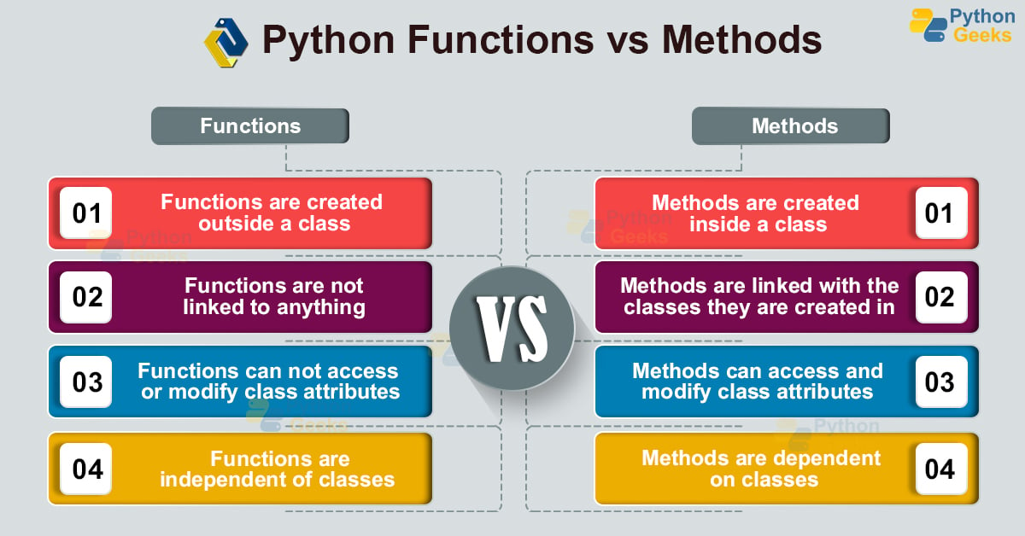
Difference between Functions and Modules

Slide 9
What is data Manipulation?
In Python, data manipulation refers to the process of changing, cleaning, and rearranging data in order to extract valuable insights or prepare it for further analysis. Data manipulation is an important stage in data analysis, machine learning, data science, and many other data-related tasks. Python provides various libraries and tools for data manipulation, the most noteworthy of which are Pandas and NumPy.
Data manipulation in Python is a key ability for data analysts, data scientists, and anyone who works with data. Pandas, in particular, is a strong library that simplifies and speeds data manipulation processes, making it a popular choice in the data science community. Effective data manipulation is critical for deriving useful insights from raw data and making educated decisions.

Slide 10
Types of String Manipulation
Data Cleaning
Data Filtering and Selection
Data Transformation
Data Conversion
Data Merging and Joining
Data Splitting
Data Aggregation and Summarization
Data Deduplication
Data Imputation
Data Scaling and Normalization

Slide 11
Examples of data Manipulation
Filtering values based on a condition:
To exclusively work with certain data that matches the requirements given by the rules, we would need to employ the relevant data manipulation. In this data manipulation technique, we would use the.loc function, which allows us to access a collection of rows and/or columns by utilizing a Boolean array or labels.
Apply a certain function to create either a new variable or perform related operations:
To apply a certain function across rows or columns, we would utilize pandas' apply function. This function applies the relevant defined function to the respective axis (0 for columns and 1 for rows) and finally returns the required variable.

Slide 12
Using a pivot function to aggregate across the desired column:
This method works similar to the pivot functionality in excel. Here we would pivot our data across the index and perform the required aggregation on other columns as per the requirement. The function we use here is .pivot.
Merge of 2 tables:
In normal real-life scenarios, it is nearly impossible to have all the data residing in one data table, and hence this functionality comes in very handy to merge 2 datasets on the basis of a key and can be declared as a parameter in the function “.merge”
Sorting a table:
Using this data manipulation we can sort a table on the basis of keys that will be passed as parameters to the function “.sort_values”. One can also pass a list of columns and on the basis of the chronological order, the table would get sorted.

Slide 13
Conclusion
In conclusion, functions, modules, and data manipulation are the foundations of Python's variety and power as a programming language. Functions allow reusable code to be encapsulated, boosting code modularity and improving code readability. Modules improve Python's capabilities by allowing code to be organized into reusable libraries, making large-scale projects easier to manage. Furthermore, data manipulation lies at the heart of Python's data science and analytical capabilities, with libraries such as NumPy and pandas providing powerful tools for quickly working with data.Python's support for functions and modules promotes clean and maintainable code, and its data manipulation features allow developers and data scientists to easily alter and analyze data.

Slide 14
Thank you

